Slide 1
CNN classification for OCT in PyTorch
Mir. H

Slide 2
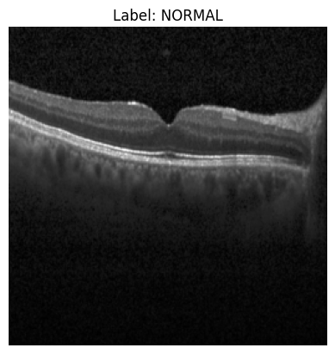
Imagine a greyscale image.
This is a picture of an eye.

Slide 3
What is OCT?
Retinal optical coherence tomography (OCT) is an imaging technique used to capture high-resolution cross sections of the retinas of living patients.

Slide 4
Now imagine 84484 different 256pxl x 256pxl greyscale .jpeg images of different eyes. And PyTorch.
We want to build a model that can predict if any of the following diseases are present in the eye: CNV, DME, DRUSEN, NORMAL on a new 256pxl by 256pxl greyscale of an eye.
We have 84484 greyscale images of adult patient retinas from the Shiley Eye Institute of the University of California San Diego, the California Retinal Research Foundation, Medical Center Ophthalmology Associates, the Shanghai First People’s Hospital, and Beijing Tongren Eye Center between July 1, 2013 and March 1, 2017. organized in folders by diagnosis CNV, DME, DRUSEN, and NORMAL.
This was based on the opinion of four ophthalmologists, two expert senior retinal specialists and many other researchers.

Slide 5
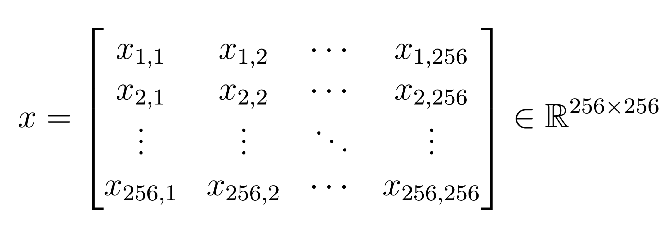
What is a 256pxl by 256pxl greyscale image actually? What is the structure?

Slide 6
But what about color? RGB?
Easy! You have a 3x256x256 matrix of values corresponding to RGB color brightness at every pixel in the image.
256
256

Slide 7
This is a single RGB pixel, composed of three different subpixels and their brightness in some range, usually [0, 256].

Slide 8
Preprocessing
import torch
from torchvision import datasets, transforms
transform = transforms.Compose([
transforms.Grayscale(num_output_channels=1), # Map to one channel via a linear combination of input channels.
transforms.Resize((256, 256)), # Resize all images to be 256pxl by 256 pxl.
transforms.ToTensor(), # Converts image to a tensor and maps values to [0,1].
transforms.Normalize(mean=[0.5], std=[0.5]) # normalize values using (x - mean)/std, so 0 - .5 / .5 = -1 and 1 -. 5/.5 = 1.
# Thus, all values are mapped to [-1,1].
])
# Create datasets using ImageFolder class
train_dataset = datasets.ImageFolder(root_train_set, transform=transform)
val_dataset = datasets.ImageFolder(root_validation_set, transform=transform)
test_dataset = datasets.ImageFolder(root_test_set, transform=transform)
# We now have transformed our datasets to datatype 1x256x256 tensors of floats with values in [-1,1].

Slide 9
ImageFolder()
The ImageFolder class in PyTorch loads images from a directory where each subfolder corresponds to a class label.
All images are passed through a specified transform pipeline, and the dataset returns image–label pairs, where labels are encoded as numeric indices.
The class indices are assigned based on the alphabetical order class folders
Thus, our classes are mapped as:
[CNV, DME, DRUSEN, and NORMAL] -> [0, 1, 2, 3]
Each sample as a tensor will now have a corresponding numeric class label.

Slide 10
CNN
Create a convolutional neural network that maps each grayscale eye image to a sequence of learned feature maps.
Define a class EyeNet that inherits the nn.Module base class from PyTorch.
import torch.nn as nn
class EyeNet(nn.Module):
def __init__(self): # the constructor, define the CNN layers here
super(EyeNet, self).__init__() # method calling PyTorch base class constructor.
def forward(self, x): # organize the forward step here
pass

Slide 11
Define the following architecture.
import torch.nn.functional as F
class EyeNet(nn.Module):
def __init__(self):
super(EyeNet, self).__init__()
self.convolve = …
self.pool = …
self.dense = …
self.dense_out = …
def forward(self, x):
x = self.convolve(x)
x = F.relu(x)
x = self.pool(x)
x = torch.flatten(x, 1)
x = self.dense(x)
x = F.relu(x)
x = self.dense_out(x)
return x

Slide 12
Convolutional layer
We have the image as a tensor now we need to obtain feature maps.
Define a convolutional layer with kernel_size=3.
class EyeNet(nn.Module):
def __init__(self):
super(EyeNet, self).__init__()
self.convolve = nn.Conv2d(in_channels=1,
out_channels=32,
kernel_size=3)

Slide 13
What happens in the convolutional layer?
def convolve(x):
Take the upper left corner of the image to be the first 3pxlx3pxl patch.
The convolutional layer produces a feature map by the following:
Take 3x3 patches of the image (represented in tensor form)
Take a 3x3 matrix of randomly-initialized weights called the kernel.
Take a randomly initialized bias term.
Then elementwise multiply the 3x3 kernel with the 3x3 patch.
Then sum all entries in the transformed patch. Finally add the bias term.
Repeat for all subsequent valid patches with the same kernel and bias term.
Construct the feature map as the matrix of the output scalars with entries corresponding to the original patch’s position.

Slide 14
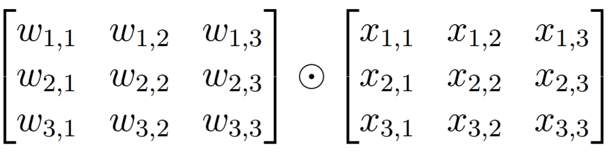
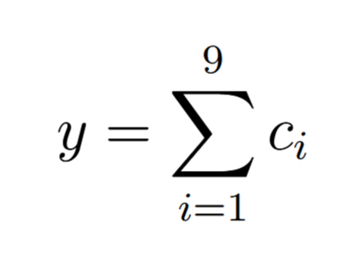
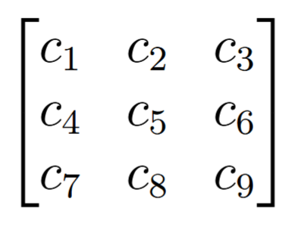
1.
= C
=
=
K
3x3 patch
2.
C =
3.
4. z = y + bias
5. Construct the feature map as a tensor of output scalars z.

Slide 15
Feature map
Every valid 3x3 patch produces a respective scalar value in the feature map.
This operation transforms the shape of our input tensor from
(1, 256, 256) to (1, 254, 254).
Where does the shrinking in dimension come from?
The kernel cannot act on patches starting at x=255 or y=255. This is because the patch contains indices that will exceed the boundary of the image. The function moves on to the next valid patch. At the end a shape of (1, 254, 254).
F_map_dim = [(x – k + 2p)/s] + 1
x = input height/width, k = kernel height/width, p = padding, s = stride

Slide 16
On stride and padding
Stride controls how the convolutional kernel moves across the input image. A stride of 1 means the kernel shifts one pixel at a time and evaluates every possible patch. A stride of 2 means the kernel moves two pixels at a time, skipping intermediate positions.
Padding adds additional pixels (usually set to 0) to the image to control the dimension of the feature maps. In our case, we lose 2 pixels of width and height when we apply the first convolutional layer. Let’s account for that by setting a padding of 1. This gives us back a 256x256 map.

Slide 17
On stride and padding (cont.)
In the torch model we defined the first convolutional layer as follows:
self.convolve = nn.Conv2d(in_channels=1,
out_channels=32,
kernel_size=3)
Omitting arguments for stride and padding sets them to default 1 and 0 respectively.
self.convolve = nn.Conv2d(in_channels=1,
out_channels=32,
kernel_size=3,
stride=1,
padding=0)

Slide 18
Output channels
Performing the convolution as described before resulted in outputting a single feature map based off a single kernel and bias totaling 10 learnable parameters. But in the EyeNet class we specified the first convolutional layer to output 32 channels/feature maps.
self.convolve = nn.Conv2d(1, 32, 3)
Thus, the first layer introduces 32 different kernels and bias terms. Each pair corresponding to 32 different feature maps.
Results in (9+1) * 32 = 320 parameters in the first layer.

Slide 19
Kernels for multiple channels
In self.convolve we used a kernel of size 3 which operates on 3x3 patches of our single input image.
Now remember the shape of our preprocessed image is (1, 256, 256).
This means our input has a depth of 1 and so we apply a (1x3x3) kernel.
To have kernels operate across multiple channels we really use a kernel of dimension 1x3x3. A convolution layer such as
self.convolve = nn.Conv2d(32, 1, 3) uses a 32x3x3 kernel that operates on 32x3x3 regions of the input. nn.Conv2d(32, 7, 3) uses 7 32x3x3 kernels.
Thus, the number of parameters a convolutional layer introduces is given by: conv_params = (input_channel*kernel_size*kernel_size+1) * output channels.

Slide 20


Activation function
We can now pass that feature map into an activation function to introduce nonlinear effects in the model. We will use the ReLU function
Thus, after we pass in the feature maps from the convolutional layer we obtain maps containing strictly positive entries and zeros for previously negative entries.

Slide 21
Pooling
Pooling is loosely defined as combining nearby data into one representative value.
Max pooling operates on local patches of the feature map, similar to convolution. A sliding window (kernel) moves across the input, and each region is reduced to its maximum value.
We will use the MaxPool2d() method in PyTorch.

Slide 22
MaxPool2d()
class EyeNet(nn.Module):
def __init__(self):
super(EyeNet, self).__init__()
self.pool = MaxPool2d(kernel_size=2, stride=2)
Here we specify the size of the patches and the subsets of patches to operate on with the stride parameter. Stride=2 means perform the algorithm on 2x2 patches starting at every other pixel.
Having stride=2 produces a shape of 1x128x128, on our 1x256x256 input. We apply the same formula for dimension as the convolutional layer. This halves the dimension of the input map.

Slide 23
class EyeNet(nn.Module):
def __init__(self):
super(EyeNet, self).__init__()
self.convolve = nn.Conv2d(in_channels=1, out_channels=6, kernel_size=5, padding=1)
self.pool = nn.MaxPool2d(kernel_size=2, stride=2)
self.dense = …
self.dense_out = …
def forward(self, x):
x = self.convolve(x) # shape: (1x256x256) --> (6x252x252)
x = F.relu(x) # shape: (6x252x252) --> (6x252x252)
x = self.pool(x) # shape: (6x252x252) --> (6x126x126)
x = torch.flatten(x, 1) # shape: (6x126x126) --> (1x(6*126*126))
x = self.dense(x)
x = F.relu(x)
x = self.dense_out(x)
return x

Slide 24
Fully-connected layers
After obtaining a final set of feature maps from the network, flatten the tensor into a 1-dimensional array and feed into the multilayer perceptron portion of the net for classification.
The 1-D array of values is taken in and connected to a specified number of output neurons each with a set of weights, one for each element in the array , and an additional bias terms. Thus, the number of parameters for the initial dense layer can be calculated as:
# of parameters in initial dense layer
= len(flattened_features) * output_neurons + output_neurons
(number of weights plus bias terms for the first layer)

Slide 25
Construct hidden layers and the output layer for classification.
We can define additional hidden layers simply by passing in the size of the input into a set of output neurons. Each layer increases the number of parameters by the following:
# of new parameters per hidden layer
= input_size * output_size + output_size
The output layer needs to classify the input into one of four classes:
[CNV, DME, DRUSEN, NORMAL]
We require the output layer to have four output neurons.

Slide 26
class EyeNet(nn.Module):
def __init__(self):
super(EyeNet, self).__init__()
self.convolve = nn.Conv2d(in_channels=1, out_channels=6, kernel_size=5) # introduces 1*6*5*5 + 6 parameters
self.convolve2 = nn.Conv2d(in_channels=6, out_channels=16, kernel_size=5) # introduces 6*16*5*5 + 16 parameters
self.pool = nn.MaxPool2d(kernel_size=2, stride=2)
self.dense = nn.Linear(16 * 61 * 61, 120) # introduces 16*61*61*120 + 120 parameters
self.dense2 = nn.Linear(120, 84) # introduces 120*84 + 84 parameters
self.dense_out = nn.Linear(84, 4) # introduces 84*4 + 4 parameters
def forward(self, x):
x = self.convolve(x) # shape: (1x256x256) --> (6x252x252)
x = F.relu(x) # shape: (6x252x252) --> (6x252x252)
x = self.pool(x) # shape: (6x252x252) --> (6x126x126)
x = self.convolve2(x) # shape: (6x126x126) --> (16x122x122)
x = F.relu(x)
x = self.pool(x) # shape: (16x122x122) --> (16x61x61)
x = torch.flatten(x, 1) # shape: (16x61x61) --> (1x(16*61*61))
x = self.dense(x) # shape: (16*61*61) --> (120)
x = F.relu(x)
x = self.dense2(x) # (120 ) -> (84)
x = F.relu(x)
x = self.dense_out(x) # (84) -> (4), outputs 4 logits (z1, z2, z3, z4).
return x

Slide 27
Passing in batches of images
To speed up computations, have the model train on batches of images. To do this we set up DataLoaders.
from torch.utils.data import DataLoader
train_loader = DataLoader(train_dataset, batch_size=32, shuffle=True)
val_loader = DataLoader(val_dataset, batch_size=32, shuffle=False)
test_loader = DataLoader(test_dataset, batch_size=32, shuffle=False)
Batching introduces a batch dimension to our shape.
Go from shape (batch=1 , 1, 256, 256) -> (batch=32, 1, 256, 256)

Slide 28
Loss function
Classification models must be able to output some predicted class to compare against a given training sample’s true class and ultimately predicting on unseen test samples.
After the final layer in the CNN we have 4 logits, (z1, z2, z3, z4) each corresponding to classes [0, 1, 2, 3] by index.
How do we associate logits with probabilities of a sample being any one class?
If we do that then we can make a prediction by choosing the class with the highest probability.

Slide 29
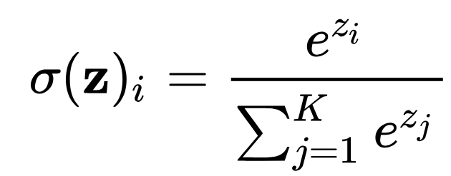
Loss function (cont.)
For multiple class problems we use the soft-max function on the logits.
The softmax activation function returns an array of transformed logits all between [0, 1] that sum to 1.
The transformed logits represent probabilties of the input being each class.
The model will predict the class based on the largest probability.

Slide 30
Loss function (cont.)
The loss/cost function measures how well the predicted logits match the true class labels.
For classification, we use the cross-entropy loss, which compares the predicted probability of the correct class to the true label.
It penalizes the model when the probability assigned to the correct class is low, and encourages the model to assign higher probability to the correct class. (Like a scorer for the model)
We use CrossEntropyLoss() from PyTorch.
Read more on the loss function in PyTorch: https://docs.pytorch.org/docs/stable/generated/torch.nn.CrossEntropyLoss.html#torch.nn.CrossEntropyLoss

Slide 31

Batching and the loss function
During training, the model processes a batch of $B$samples. The loss function computes an individual loss for each sample.
By default, PyTorch averages these losses to produce a single scalar loss used for backpropagation.

Slide 32
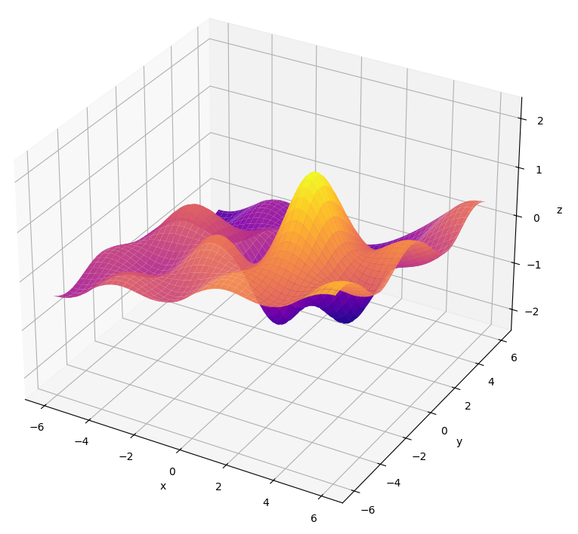
Optimizing parameters
The loss function depends on the model parameters interacting with the training data. The goal of training is to choose parameter values that minimize the loss function.
The gradient descent algorithm is performed with the optimizer solver.
Read more on gradient descent in PyTorch: https://docs.pytorch.org/docs/stable/generated/torch.optim.SGD.html#torch.optim.SGD.step

Slide 33
How many parameters in our model so far?
self.convolve = nn.Conv2d(in_channels=1, out_channels=6, kernel_size=5) # introduces 1*6*5*5 + 6 parameters
self.convolve2 = nn.Conv2d(in_channels=6, out_channels=16, kernel_size=5) # 6*16*5*5 + 16 parameters
self.dense = nn.Linear(16 * 61 * 61, 120)
# 16*61*61*120 + 120 parameters
self.dense2 = nn.Linear(120, 84)
# 120*84 + 84 parameters
self.dense_out = nn.Linear(84, 4)
# 84*4 + 4 parameters
# total_params = 156 + 2416 + 7144440 + 10164 + 340 = 7157516

Slide 34
Define loss function and optimizer
import torch.optim as optim
# Define loss function and optimizer for the backwards pass
criterion = nn.CrossEntropyLoss() # loss function which applies softmax internally
# We will use SGD with momentum to optimize parameters
optimizer = optim.SGD(eyenet.parameters(), lr = 0.001, momentum = 0.9)

Slide 35
Training loop
eyenet = EyeNet()
running_loss = 0.0
for i, data in enumerate(train_loader, 0): # Iterate over all batches in loader.
inputs, labels = data # Assign each batch to the inputs and their respective labels.
optimizer.zero_grad() # Reset parameter gradients to zero
# Forward pass, then backward pass and optimize
outputs = eyenet(inputs) # Perform the forward pass on the training samples, #gives back a batch of 32 sets of 4 logits
loss = criterion(outputs, labels) # Calculate the loss which compares the predicted #label with the true label of each training sample passed in.
loss.backward() # Perform backpropagation algorithm
optimizer.step() # Update parameters according to gradient descent on the loss.
running_loss += loss.item()

Slide 36
Enable GPU device
device = torch.device("cuda" if torch.cuda.is_available() else "cpu")
# Instantiate model on GPU
eyenet = EyeNet().to(device)
Then, in the training loop add:
for i, data in enumerate(train_loader, 0):
# Get the inputs and labels and move them to GPU
inputs, labels = data
inputs = inputs.to(device)
labels = labels.to(device)

Slide 37
from torch.utils.data import DataLoader
train_loader = DataLoader(train_dataset, batch_size=32, shuffle=True)
test_loader = DataLoader(test_dataset, batch_size=32, shuffle=False)

Slide 38
class EyeNet(nn.Module):
def __init__(self):
super(EyeNet, self).__init__()
self.convolve = nn.Conv2d(in_channels=1, out_channels=6, kernel_size=5) # introduces 1*6*5*5 + 6 parameters
self.convolve2 = nn.Conv2d(in_channels=6, out_channels=16, kernel_size=5) # introduces 6*16*5*5 + 16 parameters
self.pool = nn.MaxPool2d(kernel_size=2, stride=2)
self.dense = nn.Linear(16 * 61 * 61, 120)
self.dense2 = nn.Linear(120, 84)
self.dense_out = nn.Linear(84, 4)
def forward(self, x):
x = self.convolve(x) # shape: (1x256x256) --> (6x252x252)
x = F.relu(x) # shape: (6x252x252) --> (6x252x252)
x = self.pool(x) # shape: (6x252x252) --> (6x126x126)
x = self.convolve2(x) # shape: (6x126x126) --> (16x122x122)
x = F.relu(x)
x = self.pool(x) # shape: (16x122x122) --> (16x61x61)
x = torch.flatten(x, 1) # shape: (16x61x61) --> (1x(16*61*61))
x = self.dense(x) # shape: (16*61*61) --> (120), introduces 16*61*61*120 + 120 parameters
x = F.relu(x)
x = self.dense2(x) # (120 ) -> (84), introduces 120*84 + 84 parameters
x = F.relu(x)
x = self.dense_out(x) # (84) -> (4), introduces 84*4 + 4 parameters, outputs 4 logits (z1, z2, z3, z4).
return x

Slide 39
import torch.optim as optim
criterion = nn.CrossEntropyLoss() # loss function which applies softmax internally
optimizer = optim.SGD(eyenet.parameters(), lr = 0.001, momentum = 0.9)

Slide 40
Back to training loop
eyenet = EyeNet().to(device)
epochs = 1
for epoch in range(epochs): # loop over entire dataset
running_loss = 0.0
for i, data in enumerate(train_loader, 0): # Iterate over all batches in loader.
inputs, labels = data # Assign each batch to the inputs and their respective labels.
optimizer.zero_grad() # Reset parameter gradients to zero
inputs = inputs.to(device)
labels = labels.to(device)
# Forward pass, then backward pass and optimize
outputs = eyenet(inputs)
loss = criterion(outputs, labels)
loss.backward()
optimizer.step()
running_loss += loss.item()
print(“Training finished”)

Slide 41
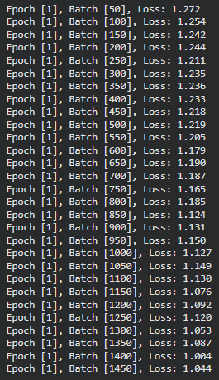
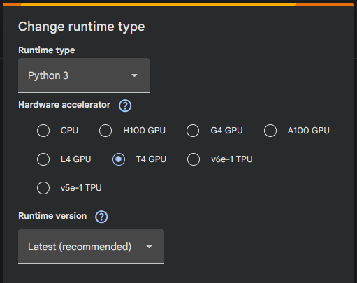
Hit GPU usage limit at approximately 4.5 hours.
Trained on 1450 batches of 32 samples before timing out.
Running loss is displayed at intervals of 50 batches.

Slide 42
BatchNorm2d()
BatchNorm2d normalizes each feature map channel using the mean and variance computed over the mini-batch, then applies learnable scaling and shifting parameters. Does not change the shape.
BatchNorm2d(input_channels) takes in the number of channels (feature maps) from the previous layer and introduces 2*input_channels learnable parameters (a scale and shift parameter per channel).
We will implement this after each convolutional layer. BatchNorm2d() introduces a bias parameter making having a bias in the previous convolutional redundant, thus it is highly recommened to set bias=False in a convolutional layer to reduce number of learning parameters during gradient descent.
Helps improve optimization during training.

Slide 43
class EyeNet(nn.Module):
def __init__(self):
super(EyeNet, self).__init__()
self.convolve = nn.Conv2d(1, 32, kernel_size=3, padding=1) # introduces 1*32*3*3 + 32 parameters
self.bn1 = nn.BatchNorm2d(32) # introduces 2*32 parameters
self.convolve2 = nn.Conv2d(32, 32, kernel_size=3 , padding=1) # introduces 32*32*3*3 + 32 parameters
self.bn2 = nn.BatchNorm2d(32)
self.pool = nn.MaxPool2d(2, 2)
self.dense_in = nn.Linear(32*128*128, 128)
self.dense_out = nn.Linear(128, 4)
def forward(self, x):
x = self.convolve(x) # 320 parameters
x = self.bn1(x) # 64 parameters
x = self.convolve2(x) # 9248
x = self.bn2(x) # 64 parameters
x = self.pool(x) # here, x has a shape of (B, 32, 128, 128)
x = torch.flatten(x,1) # flatten all dimensions of tensor except batch dimension, so start index at 1 instead of 0.
x = self.dense_in(x) # 32*128*128*128 + 128 = enormous number of parameters
x = self.dense_out(x)
return x

Slide 44
AdaptiveAvgPool()
AdaptiveAvgPool2d(output_size) is a pooling algorithm that takes a tuple (h,w) and transforms each channel so that its spatial dimensions become (h,w).
Using AdaptiveAvgPool2d((1,1)) reduces each feature map to a single value, producing an output of shape (B, channels, 1,1).
This greatly reduces the number of parameters to just the number of feature maps required in the dense layers.

Slide 45
class EyeNet(nn.Module):
def __init__(self):
super(EyeNet, self).__init__()
self.convolve = nn.Conv2d(1, 32, kernel_size=3, padding=1) # introduces 1*32*3*3 + 32 parameters
self.bn1 = nn.BatchNorm2d(32) # introduces 2*32 parameters
self.convolve2 = nn.Conv2d(32, 32, kernel_size=3 , padding=1) # introduces 32*32*3*3 + 32 parameters
self.bn2 = nn.BatchNorm2d(32)
self.pool = nn.MaxPool2d(2, 2)
self.avg_pool = nn.AdaptiveAvgPool2d((1,1))
self.dense_in = nn.Linear(32*1*1, 128)
self.dense_out = nn.Linear(128, 4)
def forward(self, x):
x = self.convolve(x) # 320 parameters
x = self.bn1(x) # 64 parameters
x = self.convolve2(x) # 9248 parameters
x = self.bn2(x) # 64 parameters
x = self.pool(x) # Here, x has a shape of (B, 32, 128, 128)
x = self.avg_pool(x) # changes x shape to (B, 32, 1, 1)
x = torch.flatten(x,1) # flatten all dimensions of tensor except batch dimension.
x = self.dense_in(x) # 32*1*1*128 + 128 = 4224
x = self.dense_out(x) # 128*4 +4 parameters, return set of 4 logits
return x # total_parameters = 320+64+9248+64+4224+516=14436

Slide 46
New architecture
Input raw images 83484 training samples w/ shape (channels, 256, 256).
→ Transform and batch data in size of 16, # shape becomes (16, 1, 256, 256)
→ [Conv + BN + ReLU] × 2
→ MaxPool
→ [Conv + BN + ReLU] × 2
→ MaxPool
→ [Conv + BN + ReLU] x 2
→ MaxPool
→ [Conv + BN + ReLU] x 2
→ AdaptiveAvgPool (condense each final feature map to 1 scalar)
→ Dense layers
→ 4 logits whose indices correspond to the 4 classes: ['CNV', 'DME', 'DRUSEN', 'NORMAL’]
→ Loss function

Slide 47
class EyeNet(nn.Module):
def __init__(self):
super(EyeNet, self).__init__()
# block 1, after every block downsample with MaxPool()
self.convolve = nn.Conv2d(1, 32, kernel_size=3, padding=1, bias = False) # introduces 32*1*3*3 parameters
self.bn1 = nn.BatchNorm2d(32) # introduces 2*32 parameters
self.convolve2 = nn.Conv2d(32, 32, kernel_size=3 , padding=1, bias = False) # introduces 32*32*3*3 parameters
self.bn2 = nn.BatchNorm2d(32) # 64 parameters
# block 1 parameters = 288 + 64 + 9216 + 64 = 9632
# block 2
self.convolve3 = nn.Conv2d(32, 64, kernel_size=3, padding=1, bias = False) # introduces 64*32*3*3 parameters
self.bn3 = nn.BatchNorm2d(64) # introduces 2*64 parameters
self.convolve4 = nn.Conv2d(64, 64, kernel_size=3 , padding=1, bias = False) # introduces 64*64*3*3 parameters
self.bn4 = nn.BatchNorm2d(64) # introduces 128 parameters
# block 2 parameters = 18432 + 128 + 36864 + 128 = 55552
self.pool = nn.MaxPool2d(2, 2)
self.avg_pool = nn.AdaptiveAvgPool2d((1,1)) # collapses shape to (B, C, 1, 1) before dense layer
self.dense_in = nn.Linear(64, 128) # introduces 64x128 + 128 parameters
self.dense_out = nn.Linear(128, 4) # introduces 128*4 + 4 parameters
# total params = 74020

Slide 48
Add 2 additional blocks before the dense layers:
# block 3
self.convolve5 = nn.Conv2d(64, 128, kernel_size=3, padding=1, bias = False) # introduces 128*64*3*3 parameters
self.bn5 = nn.BatchNorm2d(128) # introduces 128*2 parameters
self.convolve6 = nn.Conv2d(128, 128, kernel_size=3 , padding=1, bias = False) # introduces 128*128*3*3 parameters
self.bn6 = nn.BatchNorm2d(128) # introduces 256 parameters
# block 3 parameters = 73728 + 256 + 147456 + 256 = 221696
# block 4
self.convolve7 = nn.Conv2d(128, 256, kernel_size=3, padding=1, bias = False) # introduces 256*128*3*3 parameters
self.bn7 = nn.BatchNorm2d(256) # introduces 2*256 parameters
self.convolve8 = nn.Conv2d(256, 256, kernel_size=3 , padding=1, bias = False) # introduces 256*256*3*3 parameters
self.bn8 = nn.BatchNorm2d(256) # introduces 512 parameters
# block 4 parameters = 294912 + 512 + 589824 + 512 = 885760
self.pool = nn.MaxPool2d(2, 2)
self.avg_pool = nn.AdaptiveAvgPool2d((1,1)) # collapses 256 maps to shape (B, C, 1, 1) before dense layer
self.dense_in = nn.Linear(256, 128) # introduces 256x128 + 128 parameters
self.dense_out = nn.Linear(128, 4) # introduces 128*4 + 4 parameters
# total params = 9632 + 55552 + 221696 + 885760 = 1172640

Slide 49
In the forward pass
Apply the ReLU function after every BatchNorm2d() operation in the model. Also apply activation functions between the initial dense layer and final dense layer.
Use nn.ReLU(in_place=True) to modify the input in place, not create a new object.
Use AdaptiveAvgPool2d((1,1)) on the final activated feature maps before dense layer. Then flatten the tensor for the initial dense layer.

Slide 50
Train on individual samples
from torch.utils.data import DataLoader
train_loader = DataLoader(train_dataset, batch_size=1, shuffle=True)
test_loader = DataLoader(test_dataset, batch_size=1, shuffle=False)
Let’s train for 1 epoch. That is, the model will train on each sample individually once for the entire dataset.

Slide 51
CNN Results
Training on Colab’s G4 GPU took a little over 5 minutes to get through the entire training set of 83484 images one at a time.
Now we can set the model to evaluate mode and see how well it performs on classifying images.
model.eval()
test_loss = 0.0
with torch.no_grad():
for inputs, labels in test_loader:
inputs = inputs.to(device)
labels = labels.to(device)
outputs = model(inputs)
loss = criterion(outputs, labels)
test_loss += loss.item()
# average loss avg_test_loss = test_loss / len(test_loader) # accuracy test_accuracy = 100 * correct / total

Slide 52
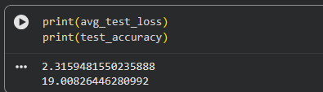
19 percent accuracy. Worse than random this is bad. But its ok we can try some things.
Let’s instantiate a new model and train on 50 epochs and batches of 16 samples.

Slide 53
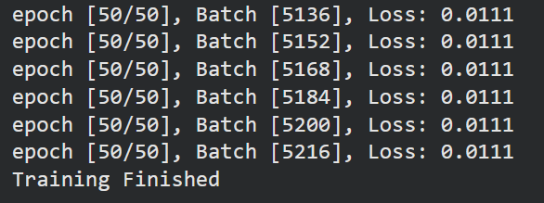


Final results of model after training for 50 epochs
3 hrs 41 seconds of training through 50 epochs on G4 GPU.
About $4 of google compute units. (40 units)
On the test set: On the validation set:

Slide 54
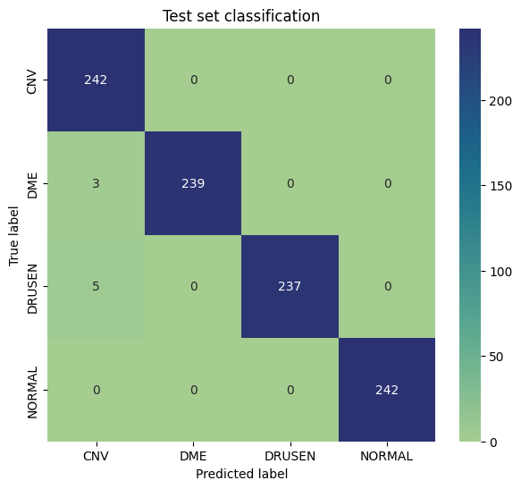
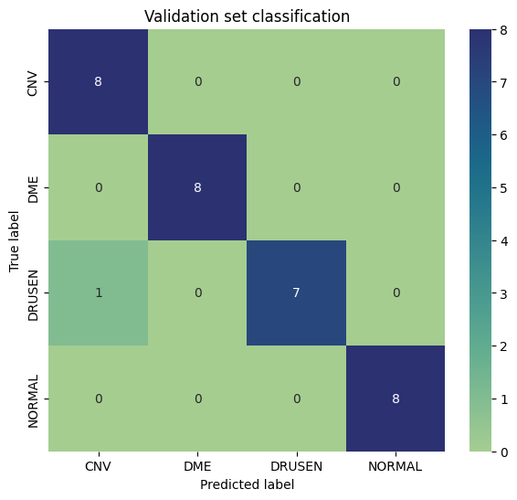
Confusion matrices

Slide 55
Applying SVM, KNN, and Random Forests using extracted features.
“While DCNNs can be used to perform classification (or other machine learning tasks such as regression) directly, typically based on the output of the last network layer, they can also act as stand-alone feature extractors with the resulting features fed into a classifier such as a SVM.”
-A Mathematical Theory of Deep Convolutional Neural Networks for Feature Extraction by Thomas Wiatowski and Helmut B¨olcskei,

Slide 56
Using the model as a feature extractor
Let’s cut the network at the point the feature maps are flattened to a one-dimensional array. Then, we can use the array as a vector of features for each sample. We can apply SVM and KNN directly from the set of all features for each sample in the training set. Then we transform the test set to a flatten vector using the trained CNN model and feed into SVM and KNN models.
To do this we must build the feature set by setting our trained classifier to evaluate mode and passing all training samples individually to be flattened. Then we build the dataset from the flattened vectors. Do the same for the test set.

Slide 57
AdaptiveAvgPool2d((1,1)) results in 256 feature maps of size (1,1).
Flattening returns an array of length 256.
Add the following function into the network class:
def extract_features(self, x):
x = self.features(x) # (B, 256, 1, 1)
x = torch.flatten(x, 1) # (B, 256)
return x

Slide 58
Code to build feature set
# get feature vectors for train set
features = []
labels = []
model.eval()
with torch.no_grad():
for inputs, y in train_loader:
inputs = inputs.to(device)
feats = model.extract_features(inputs) # (B, 256)
features.append(feats.cpu().numpy())
labels.append(y.numpy())
X_train = np.vstack(features)
y_train = np.concatenate(labels)

Slide 59

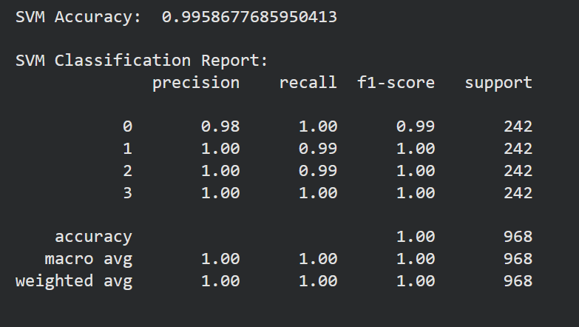
SVM results (rbf kernel)

Slide 60

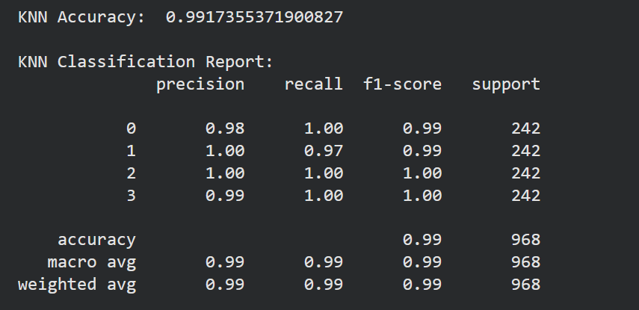
KNN results (n=5, using 2-norm)

Slide 61
What next?
Track individual patients retinal imaging over time and use recurrent neural network architecture to identify abnormalities.
Use transfer learning to integrate large database of eye scans and create more robust eye recognition models.
Multichannel input means implementing higher dimensional kernels in the initial layers could lead to very complex feature maps.

Slide 62
Sources
- Dataset sourced from Paul Mooney on Kaggle at https://www.kaggle.com/datasets/paultimothymooney/kermany2018
- PyTorch documentation
- A Mathematical Theory of Deep Convolutional Neural Networks for Feature Extraction by Thomas Wiatowski and Helmut B¨olcskei
Kaggle API
Cloud GPU training in Google Colab

